Slide 1

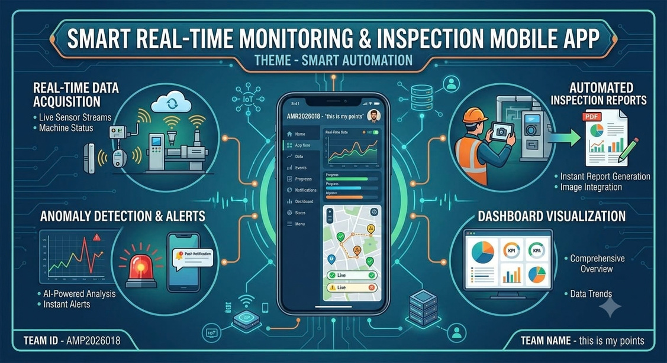
SMART INDIA HACKATHON 2026
Smart Real-Time Monitoring & Inspection Mobile App
•Problem Statement ID - SIH26095
•Problem Statement Title -Smart
Real Time Monitoring and Inspection
•Theme - Smart Automation
•PS Category - Software
•Team ID – AMP2026018
•Team Name -Smart Inspect
SMART INDIA HACKATHON 2026 • SIH26095 • Smart Automation 01

Slide 2
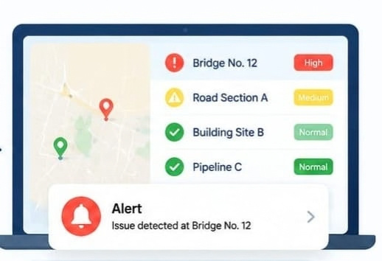
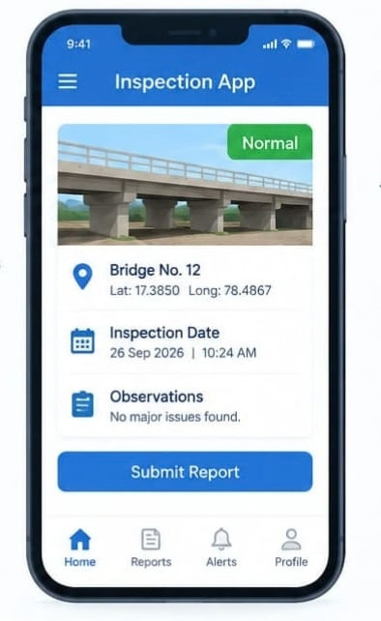

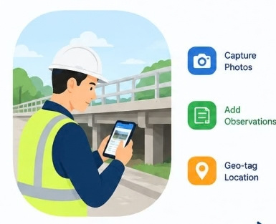
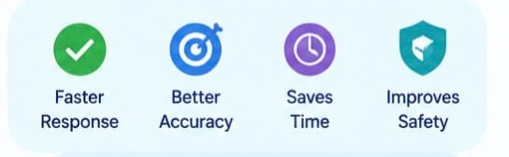
PROPOSED SOLUTION
Task Assigned → Inspector Notified → Location Verified → Checklist Completed → Evidence Uploaded → Real-Time Sync → Official Review → Action Taken → Inspection Closed
A smart mobile and web-based inspection platform that connects field inspectors with authorities through real-time task assignment, location tracking, digital checklists, and centralized monitoring.
• Eliminates paper-based inspection and manual reporting
• Provides real-time visibility of field activities
• Ensures evidence is linked to the correct location and inspection
• Enables faster identification and resolution of issues
• Maintains a centralized digital inspection record
Inspectors receive assigned inspection tasks on the mobile app, verify the location, complete digital checklists, and upload photos, videos, remarks, and other evidence. All information is instantly synchronized with the central dashboard for officials.
SMART INDIA HACKATHON 2026 • SIH26095 • Smart Automation 02

Slide 3



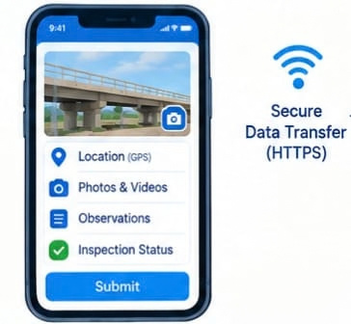
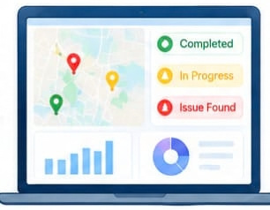

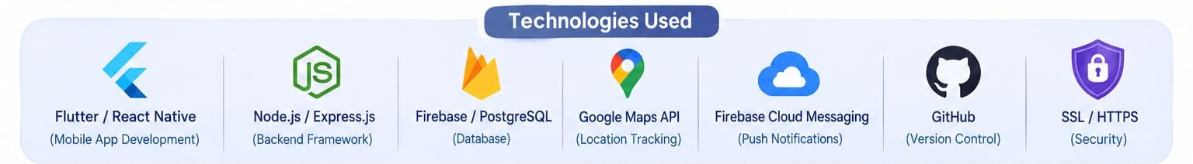
TECHNICAL APPROACH
4. Web Dashboard
2. RealtimeAPI
3.Database
1. Mobile App
PostgreSQL / PostGIS
Inspector Data • Inspection Records • GPS Data • Evidence • Audit Logs
React.js
Live Status • Inspection Tracking • Reports • Alerts
Fast API / Node.js
REST APIs • Authentication • Task Management • Real-Time Updates
Flutter / React Native
GPS • Digital Forms • Photo/Video • Notifications
SMART INDIA HACKATHON 2026 • SIH26095 • Smart Automation 03

Slide 4






FEATURES AND WORKFLOW
Feasibility
Potential Challenges & Risks
Strategies
• Software-based solution
• Uses existing mobile/web technologies
• GPS and camera supported
• Prototype can use simulated data
• No specialized hardware required
• Weak internet connectivity
• GPS accuracy problems
• Delayed data synchronization
• Large photo/video uploads
• Unauthorized access
• Offline data storage & sync
• GPS validation
• Automatic retry for failed uploads
• Image/video compression
• Secure login & access control
Prototype Scope
Scalability
A working demo can cover inspector login, inspection assignment, GPS evidence capture, photo upload, live dashboard updates, map visualization, alerts and corrective-action tracking.
The same architecture can support multiple departments, projects and districts. APIs can later connect with existing government systems, CCTV platforms and institutional databases.
SMART INDIA HACKATHON 2026 • SIH26095 • Smart Automation | 04

Slide 5




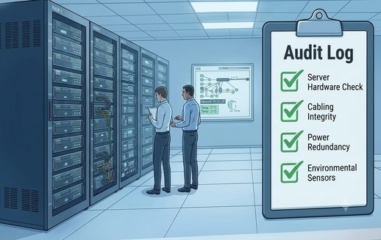
IMPACT AND BENEFITS
Faster field inspections
Real-time issue identification
Better team coordination
Reduced reporting delays
Improved accountability
Transparent inspection records
Digital evidence for verification
Reduced paperwork and delayed reportin
Easier monitoring across multiple location
For Inspectors
For Officials
For Organizations
Simple mobile workflow with task assignment, GPS verification and easy evidence upload.
Live dashboard, alerts, maps, inspection history and corrective-action tracking.
Centralized records, audit trail, faster reporting and scalable monitoring.
Expected Outcome :-
From manual inspections → to a connected, transparent and real-time inspection system.
SMART INDIA HACKATHON 2026 • SIH26095 • Smart Automation 05

Slide 6

RESEARCH AND REFERENCES
Research Basis
• We studied the problems in field inspections.
• We focused on reducing manual work and delays.
• Our solution uses GPS, digital checklists and photo evidence.
• Officials can monitor inspections from one dashboard.
Primary Reference
Smart India Hackathon 2026 — SIH26095
Smart Real-Time Monitoring & Inspection Mobile App
Theme: Smart Automation
Category: Software
Focus: Real-Time Monitoring & Inspection
Technology References
• Flutter / React Native – Mobile App
• React.js – Web Dashboard
• FastAPI / Node.js – Backend
• PostgreSQL – Database
• REST API – Data Communication
• GPS & OpenStreetMap – Location Tracking
Prototype Demonstration
Our prototype shows how an inspection can be managed digitally from task assignment to final completion.
Assign Task → Inspector Visits → GPS Verification → Checklist → Upload Evidence → Dashboard Update → Issue Resolution
SMART INDIA HACKATHON 2026 • SIH26095 • Smart Automation 06

Slide 7

THANK YOU

